Slide 1
Smart Gemology App
Final Year Project
Group Members:
Amir Suliman: 19pwcse1805
Ashfaq Ahmad: 19pwcse1795
Mansoor Hussain: 19pwcse1858
Supervisor:
Madiha Mushtaq

Slide 2
Outlines:
Introduction
User Interface Design
Integration App with Firebase
Data Set
Machine Learning
Thesis

Slide 3
Introduction
Our FYP is about gemstones.
Design an App that will detect the type of stone.
Simply we will take or upload a picture of the stone
App will identify the type of gemstone just in a few seconds.

Slide 4
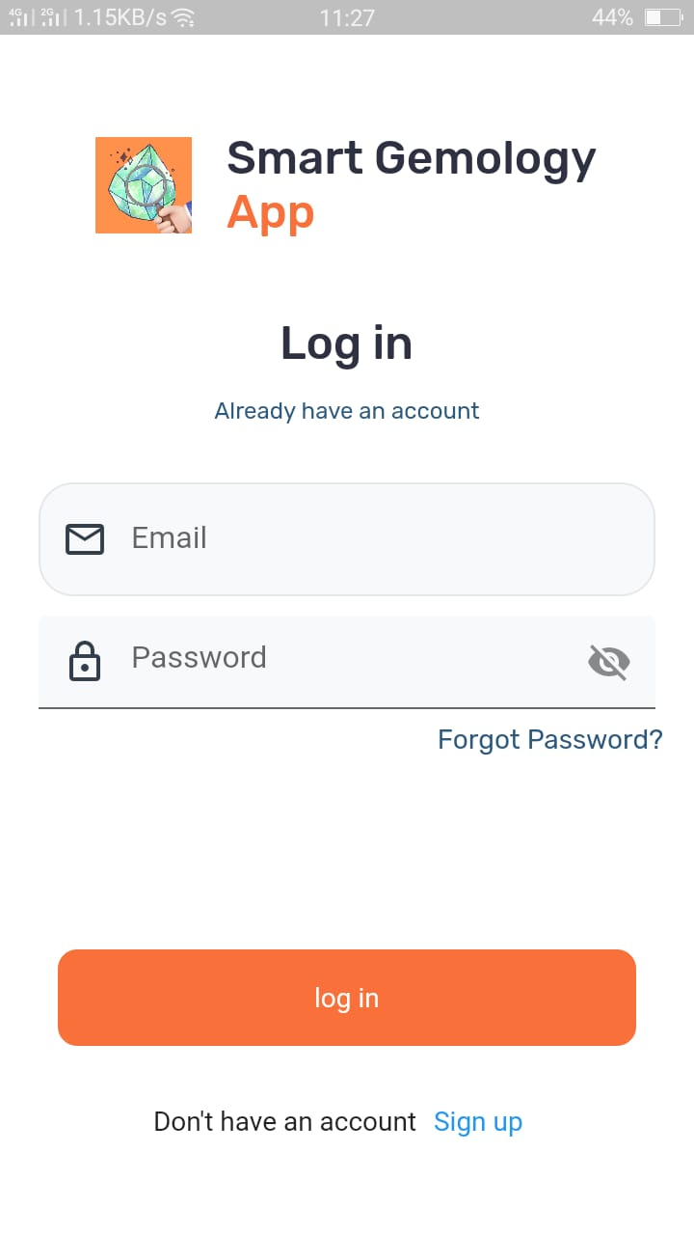
User Interface Design (UI)
A login user interface (UI) is a screen.
That allows a user to enter our Application.
Their login credentials to access the application
This is the gateway to the rest of the application.

Slide 5
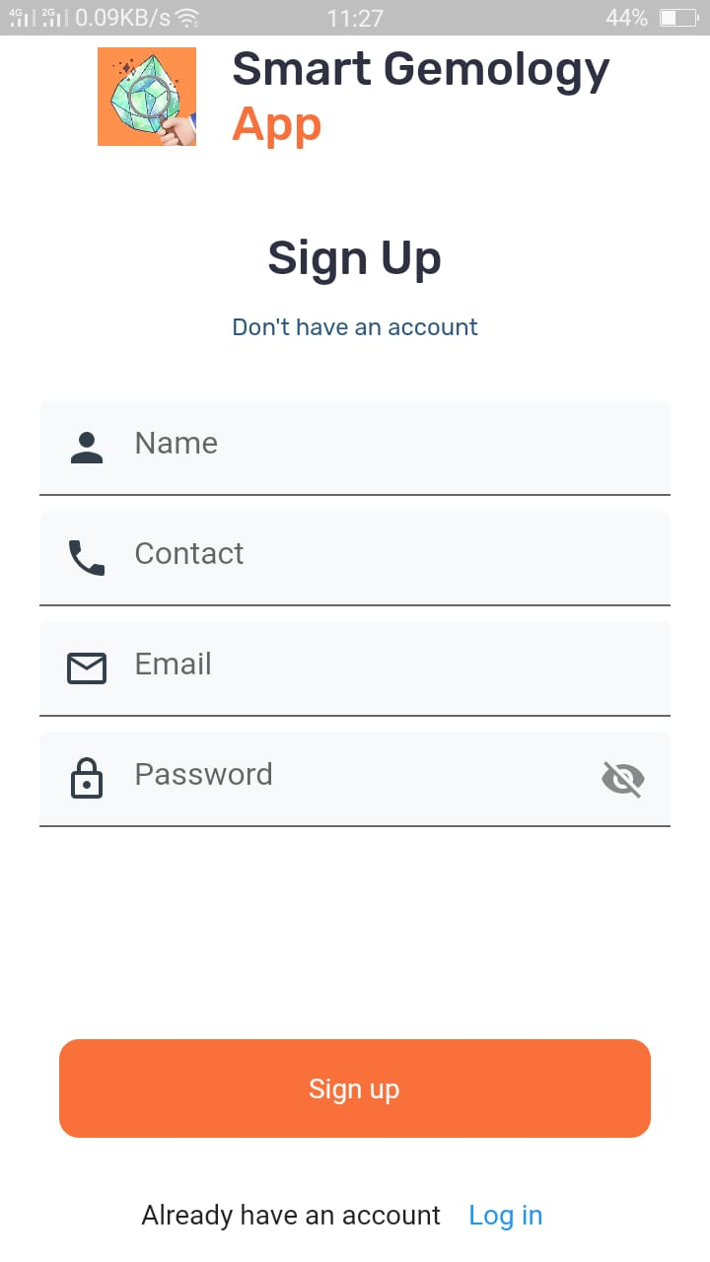
Sign Up
A sign-up user to create a new account.
user to enter their personal information
Authentication, and using secure protocols to transmit sign-up information

Slide 6
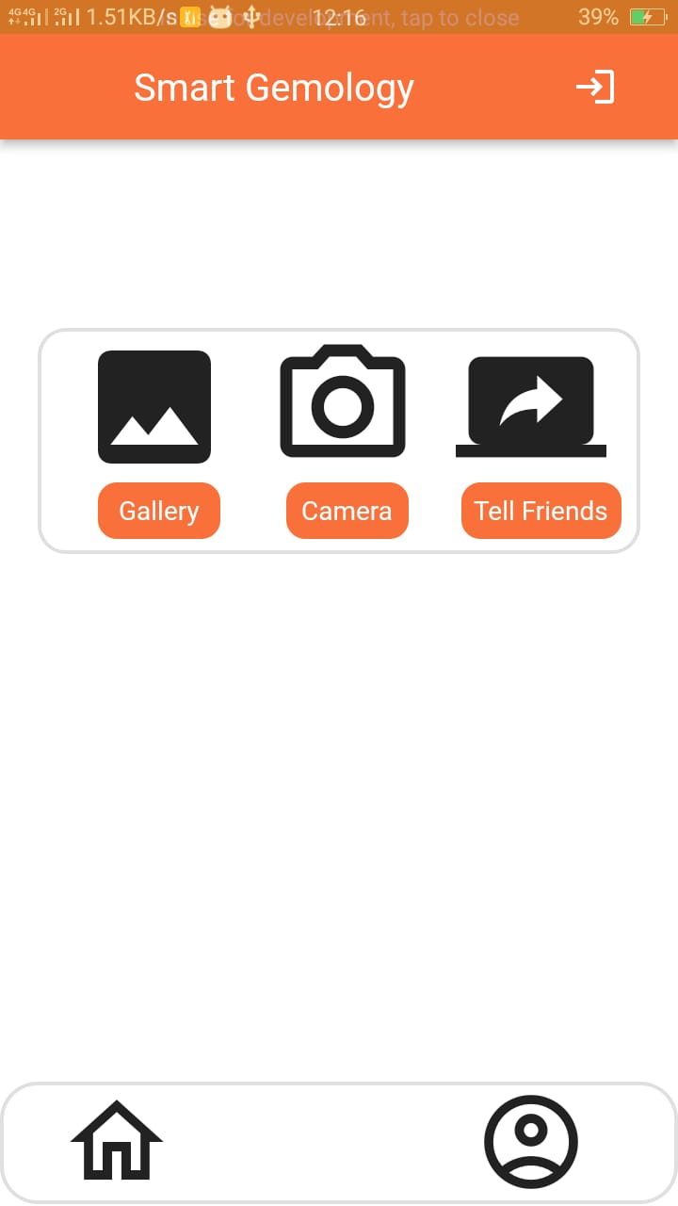
Home Page
This Home Screen UI of our App.
We can take pictures of the Gemstone from the Camera and take pictures of gemstones from the Gallery of our phone.
After it scans the gemstone and gives the name of Gemstone and its properties.

Slide 7
Integration App with Firebase
Integrating the App with firebase allows the app to use firebase features.
Authentication: Allows users to sign in to your app using their email address and password.
Firebase Realtime Database: A cloud-hosted database that allows you to store and sync data in real time.
Firebase Storage: A file storage service that allows you to upload and download files from Google Cloud Storage.

Slide 8
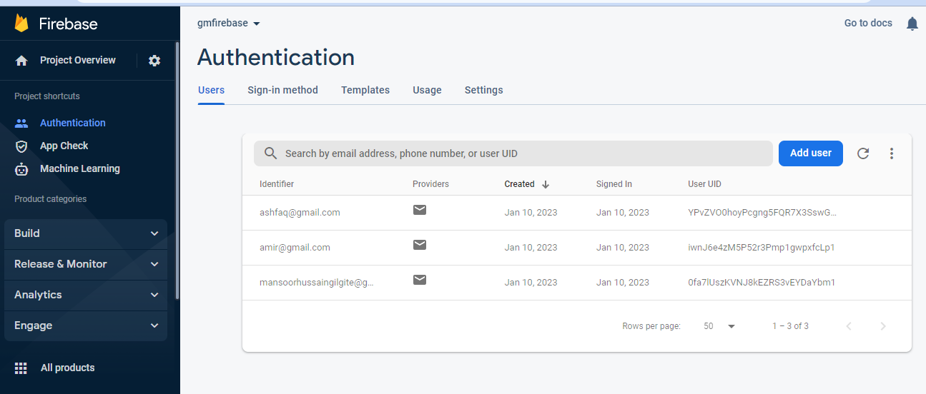
Backend connection:

Slide 9
Automatic gemstones classification’s approaches
Feature based
Deep learning Based
Hybrid methods.

Slide 10
Machine Learning algorithms
CNN and Transfer function
Random forest
Super vector machine
Decision tree.

Slide 11
Data Set
2326 Total images
Different categories of these images

Slide 12
Thesis
Completed three chapters of thesis
Introduction
Literature review
Methodology

